Slide 1
Personal Progress
Zacharia Abdi

Slide 2
Previous feedback

Slide 3
Research the professional field of media design and its various specializations
Provide more in-depth information about the specific specialization you are interested in
Validate your designs and interactive products through testing and validation
Include comments in your code for better understanding and collaboration
Note the connections and conclusions between your design iterations
Ensure that the finished products, including FED, align with LO1 requirements

Slide 4
Learning outcome 1
“You create engaging concepts and translate them into interactive validated media products by applying user-centered design principles, visual design techniques and by exploring emerging technologies.”

Slide 5
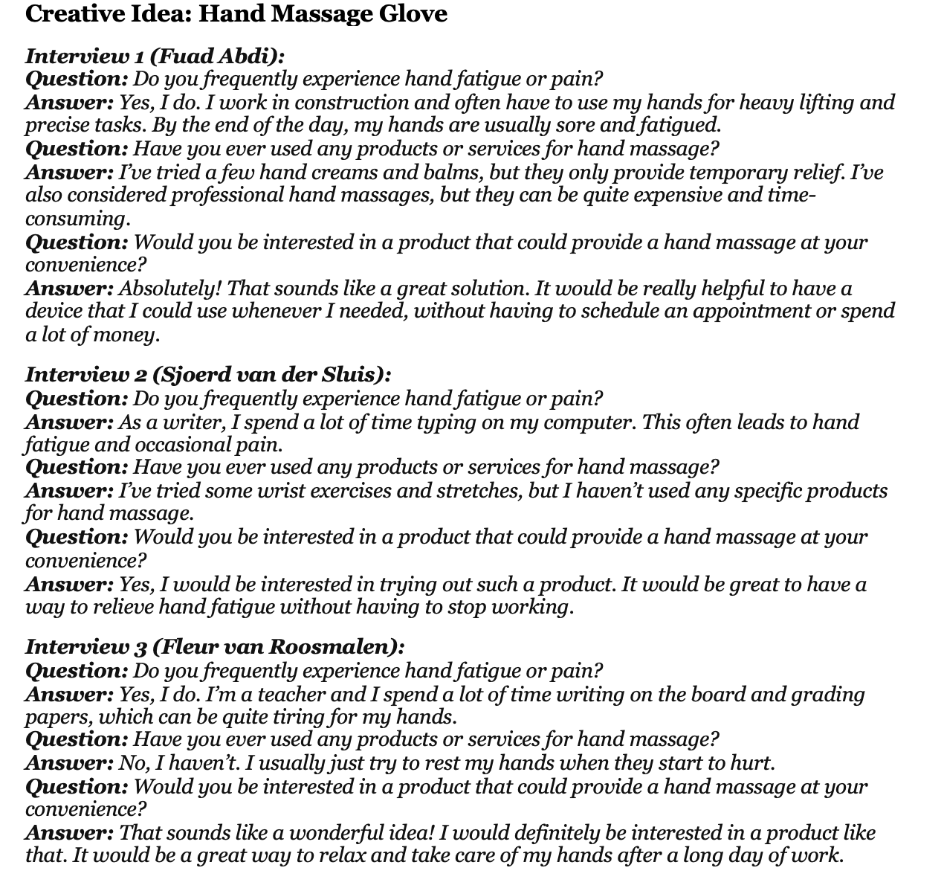

Slide 6
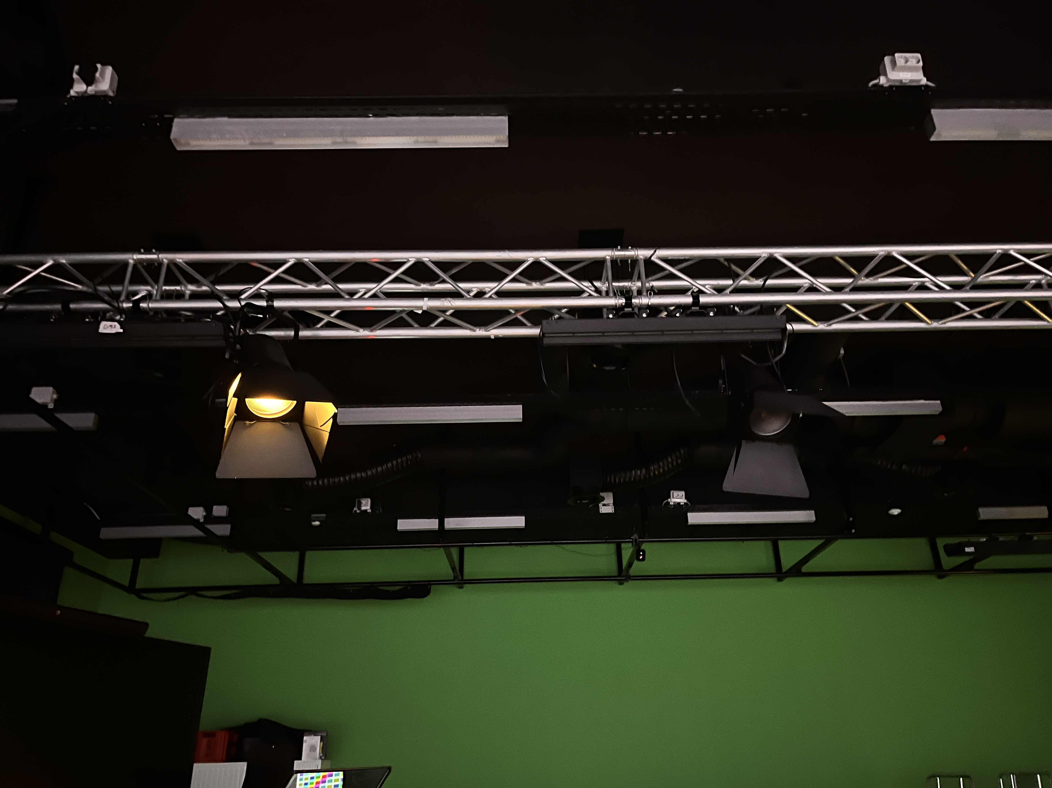
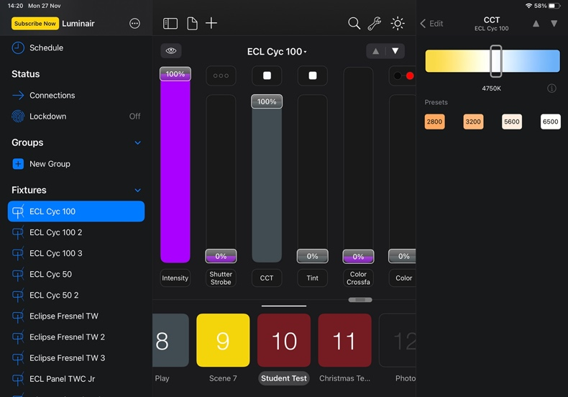
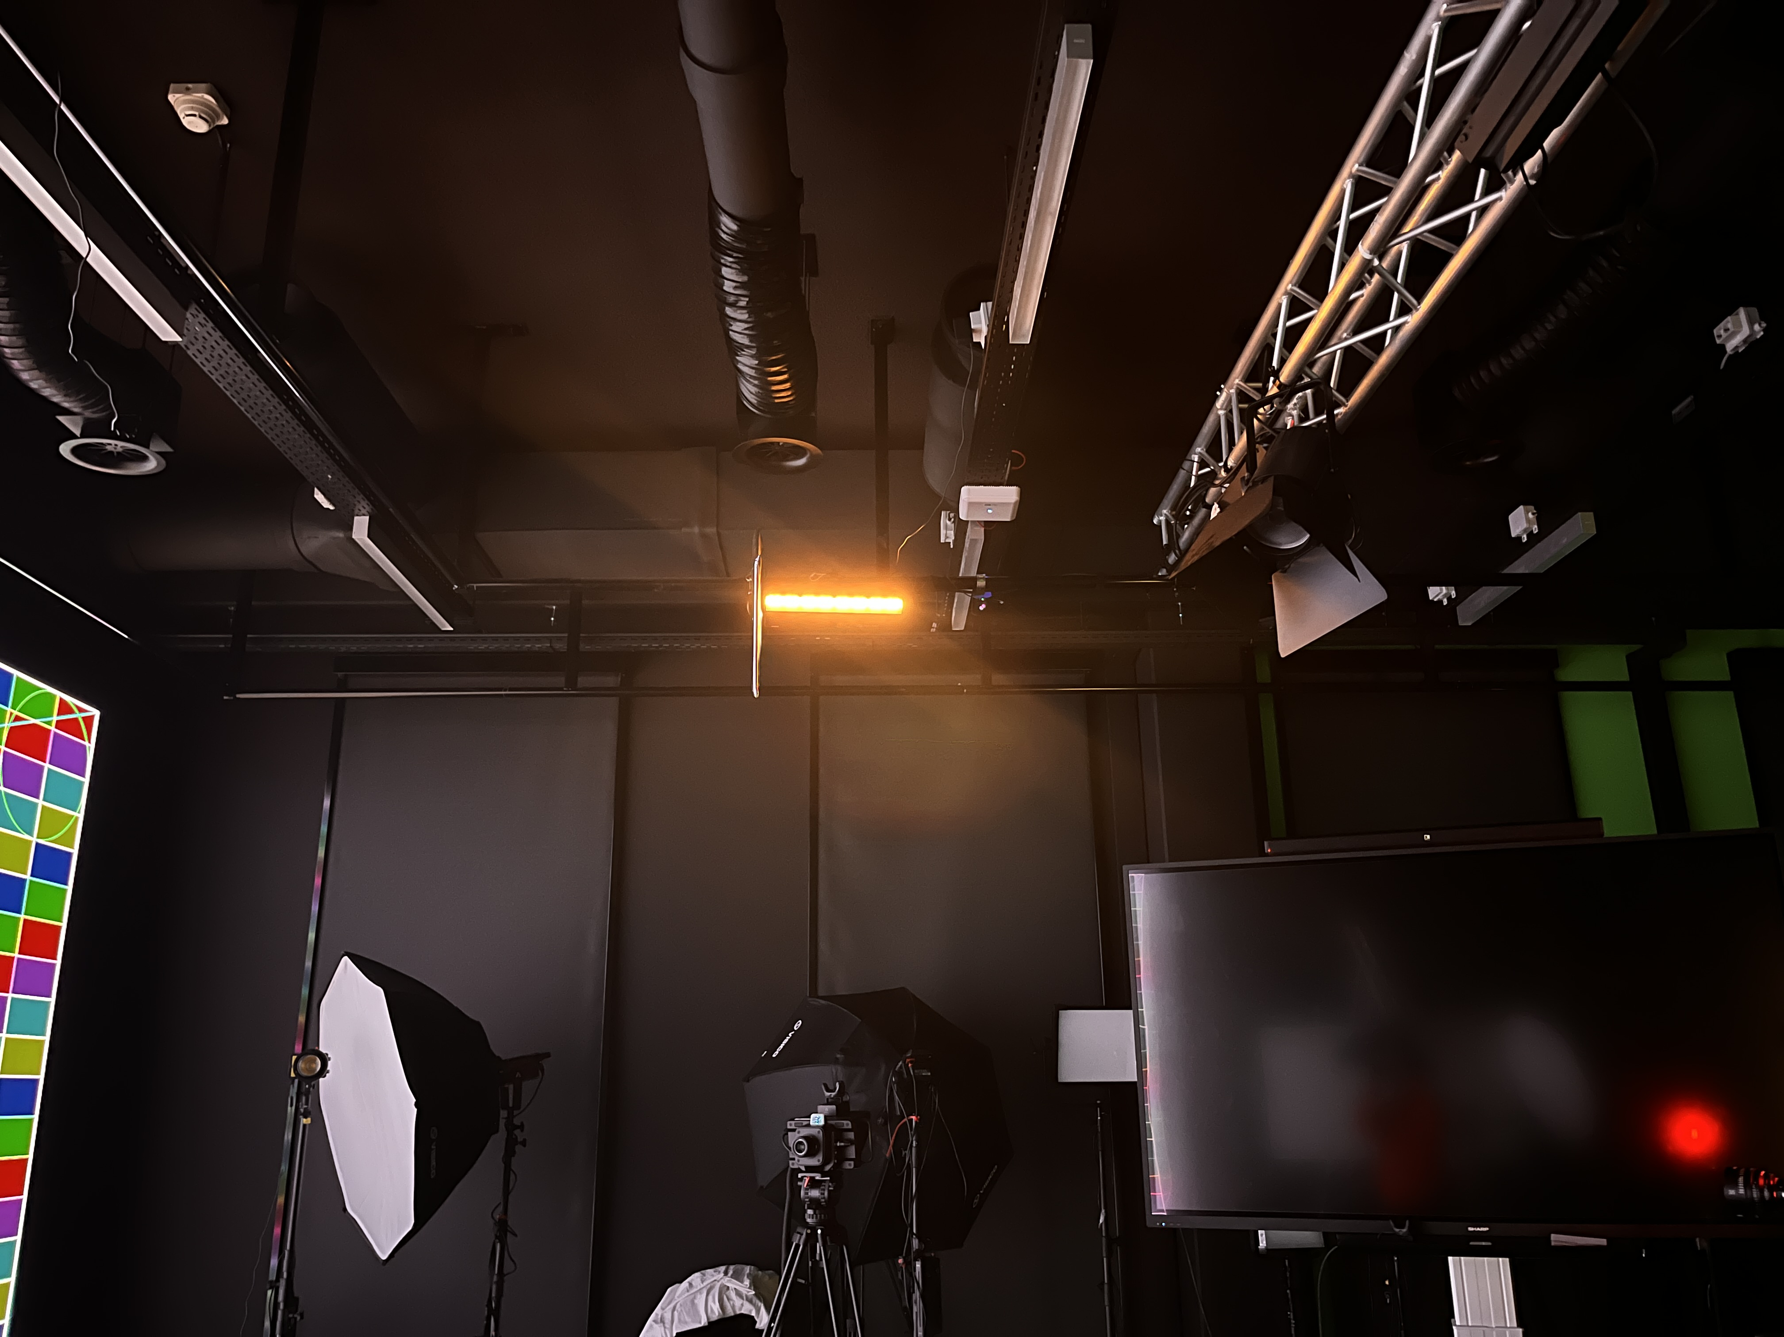

Slide 7
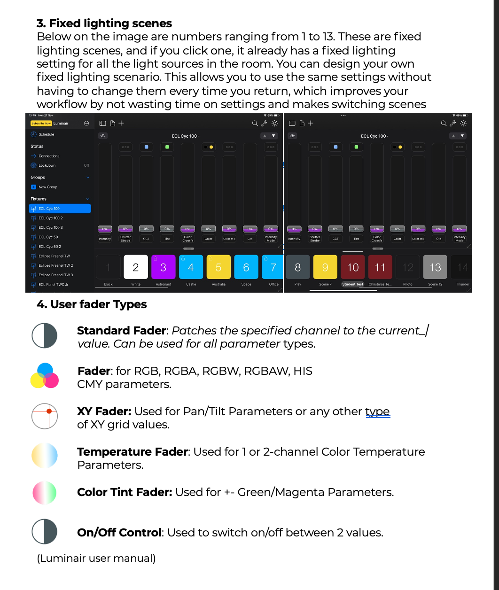
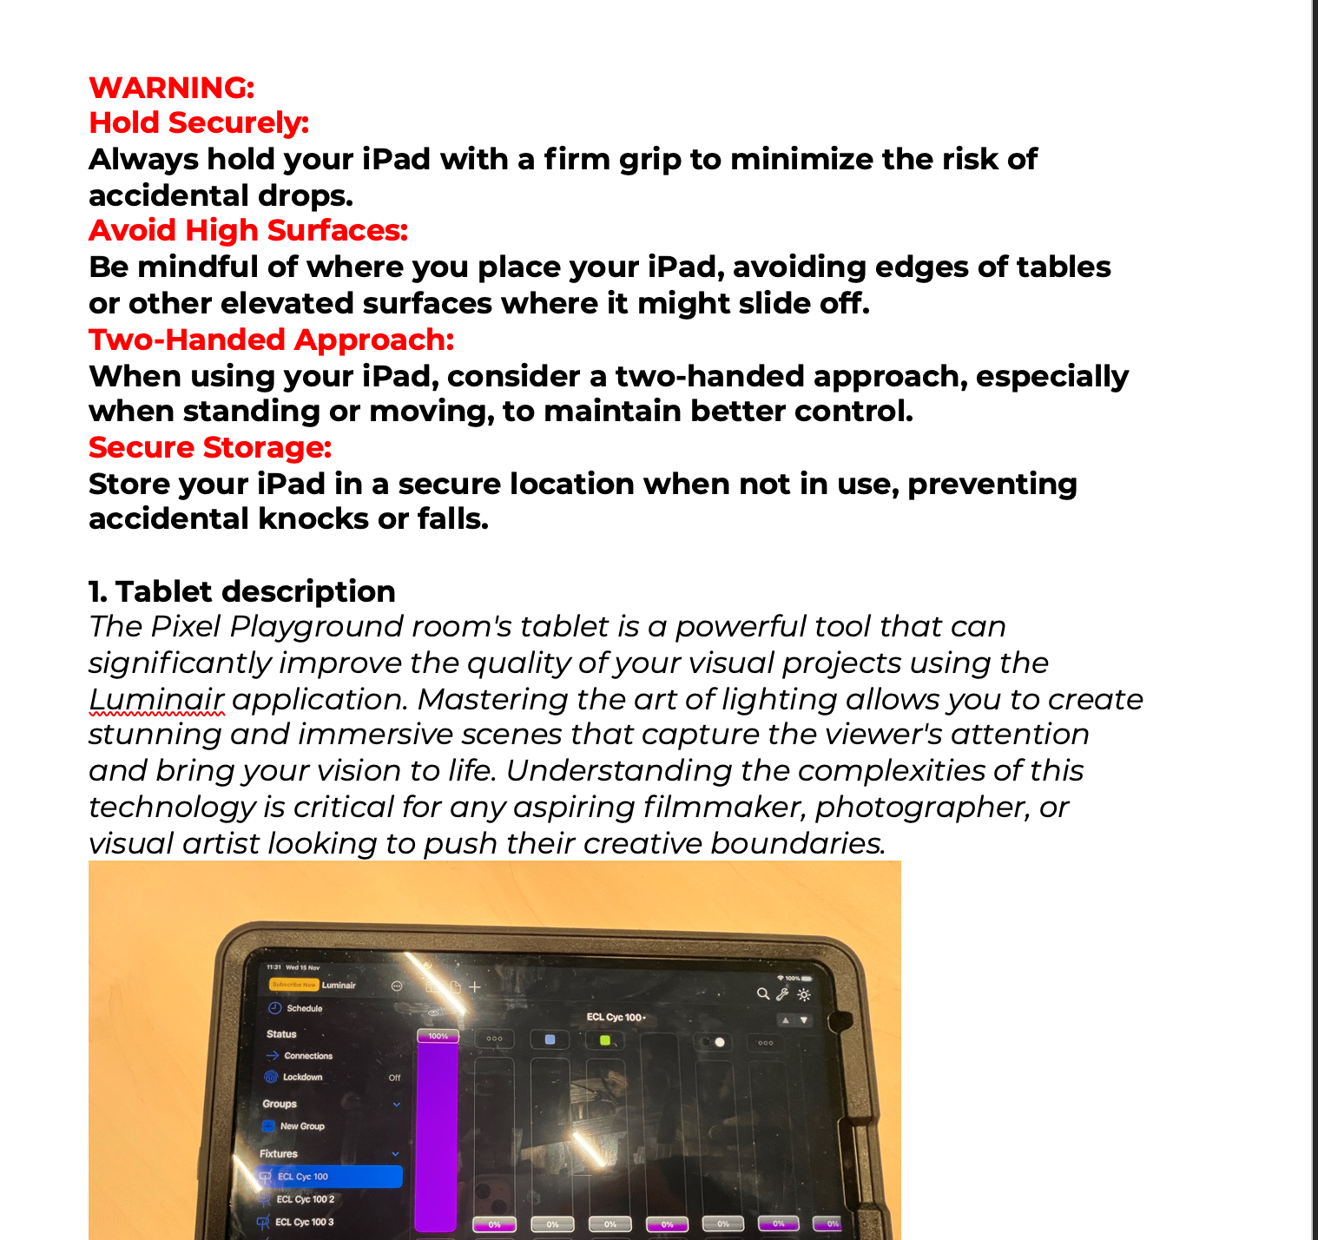

Slide 8
Learning outcome 2
“You explain and document your process, comment your code using version control in a personal and team context and communicate recommendations.”

Slide 9
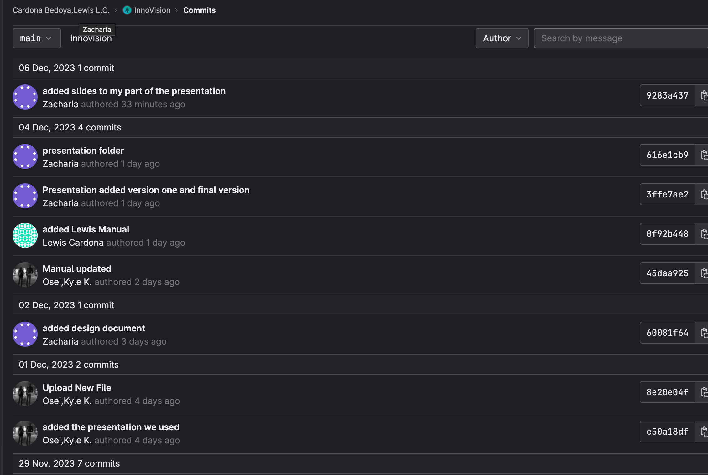
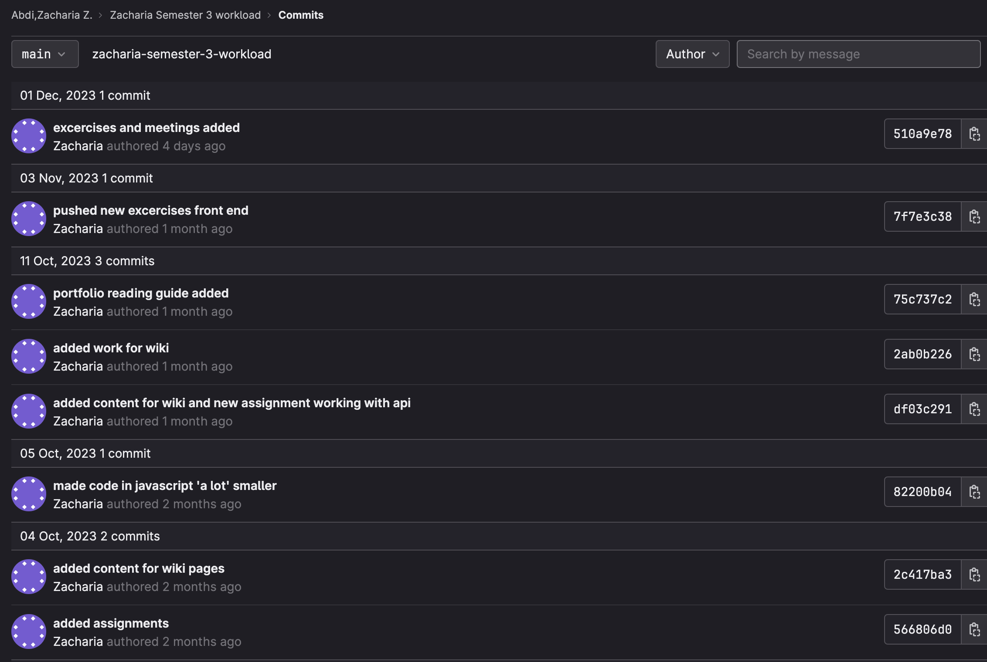

Slide 10
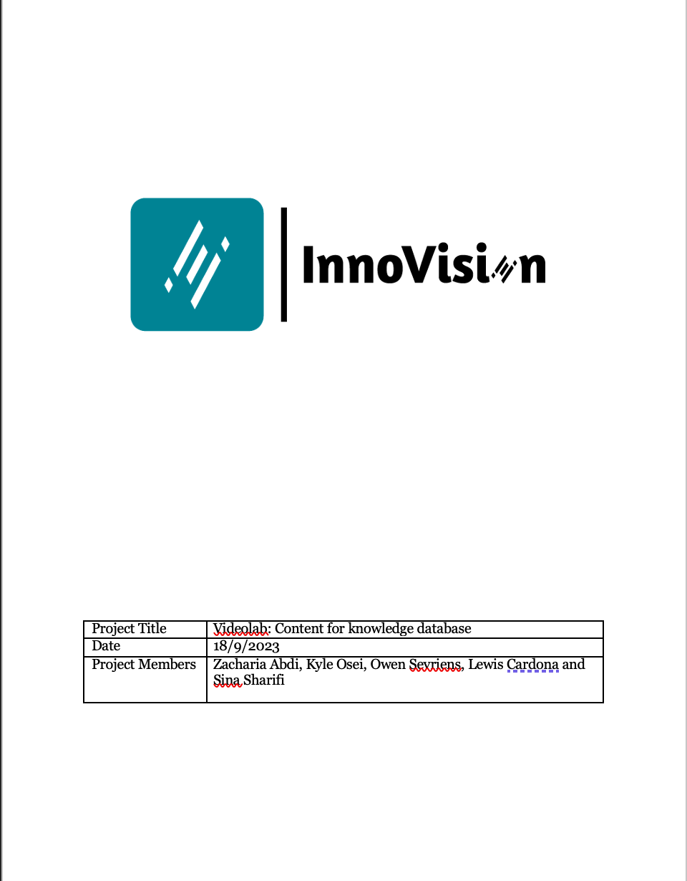
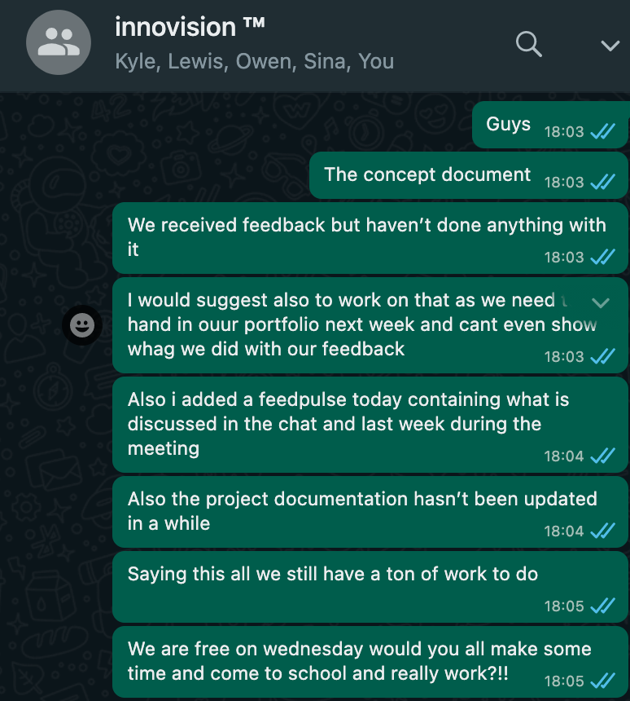

Slide 11
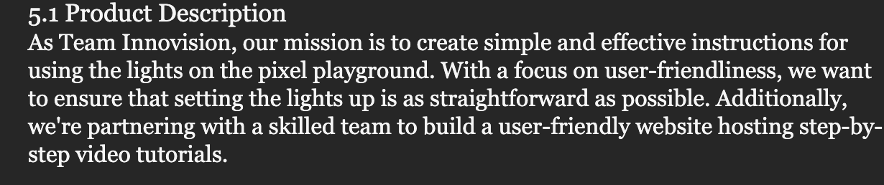
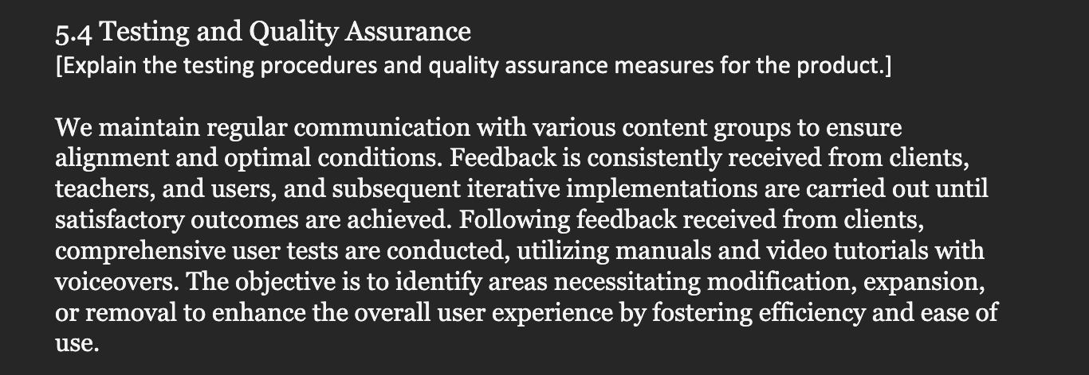

Slide 12
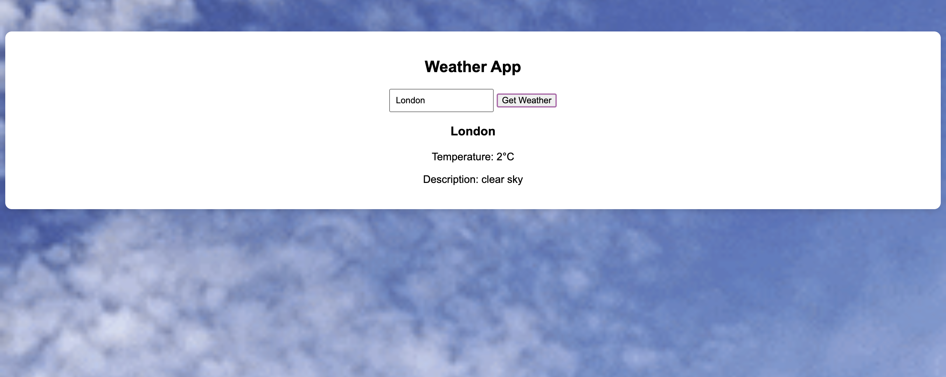

Slide 13
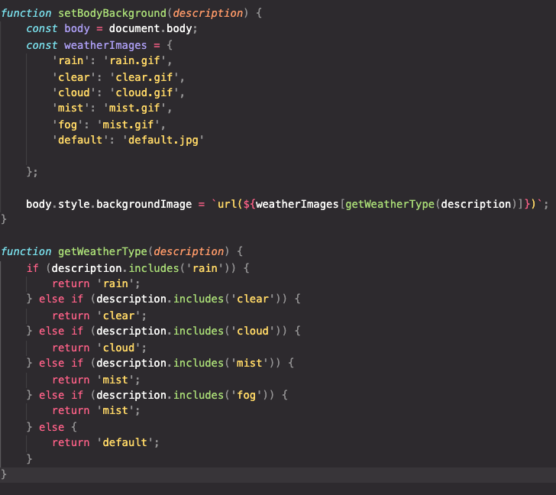

Slide 14
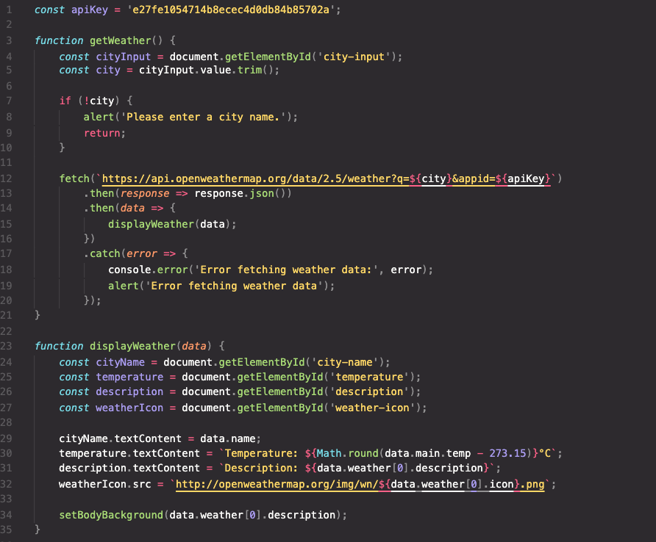

Slide 15
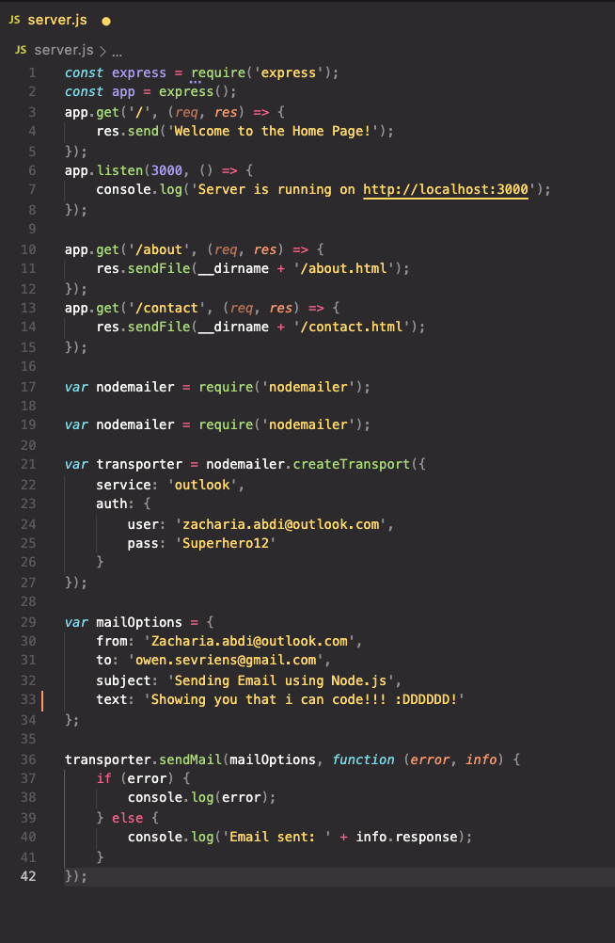
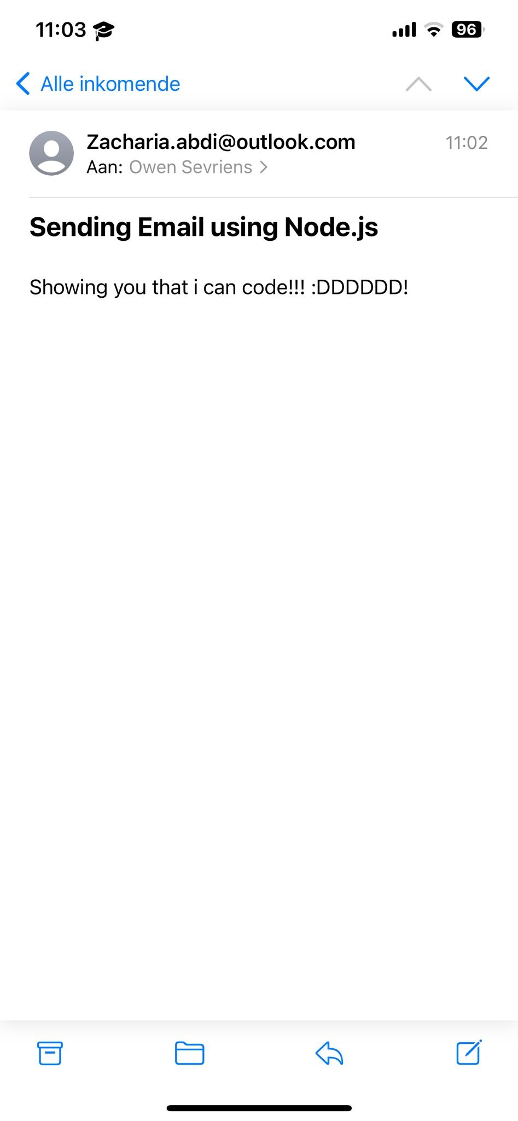
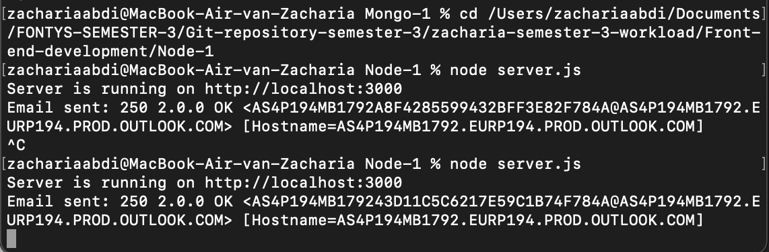

Slide 16
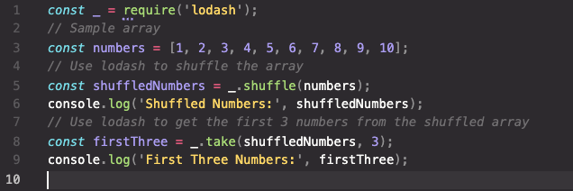
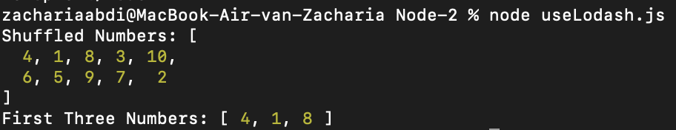

Slide 17
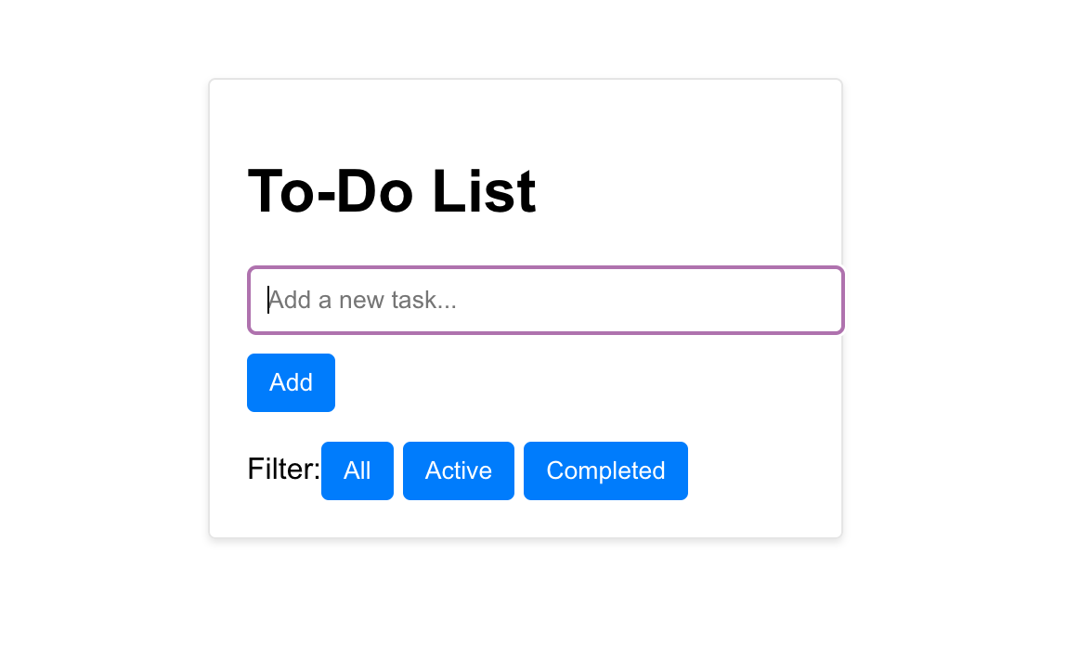
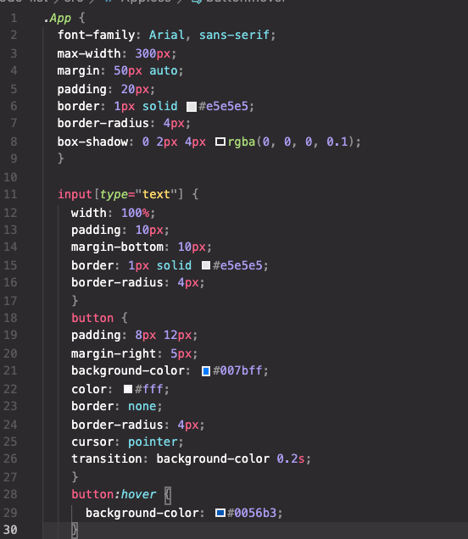
±

Slide 18
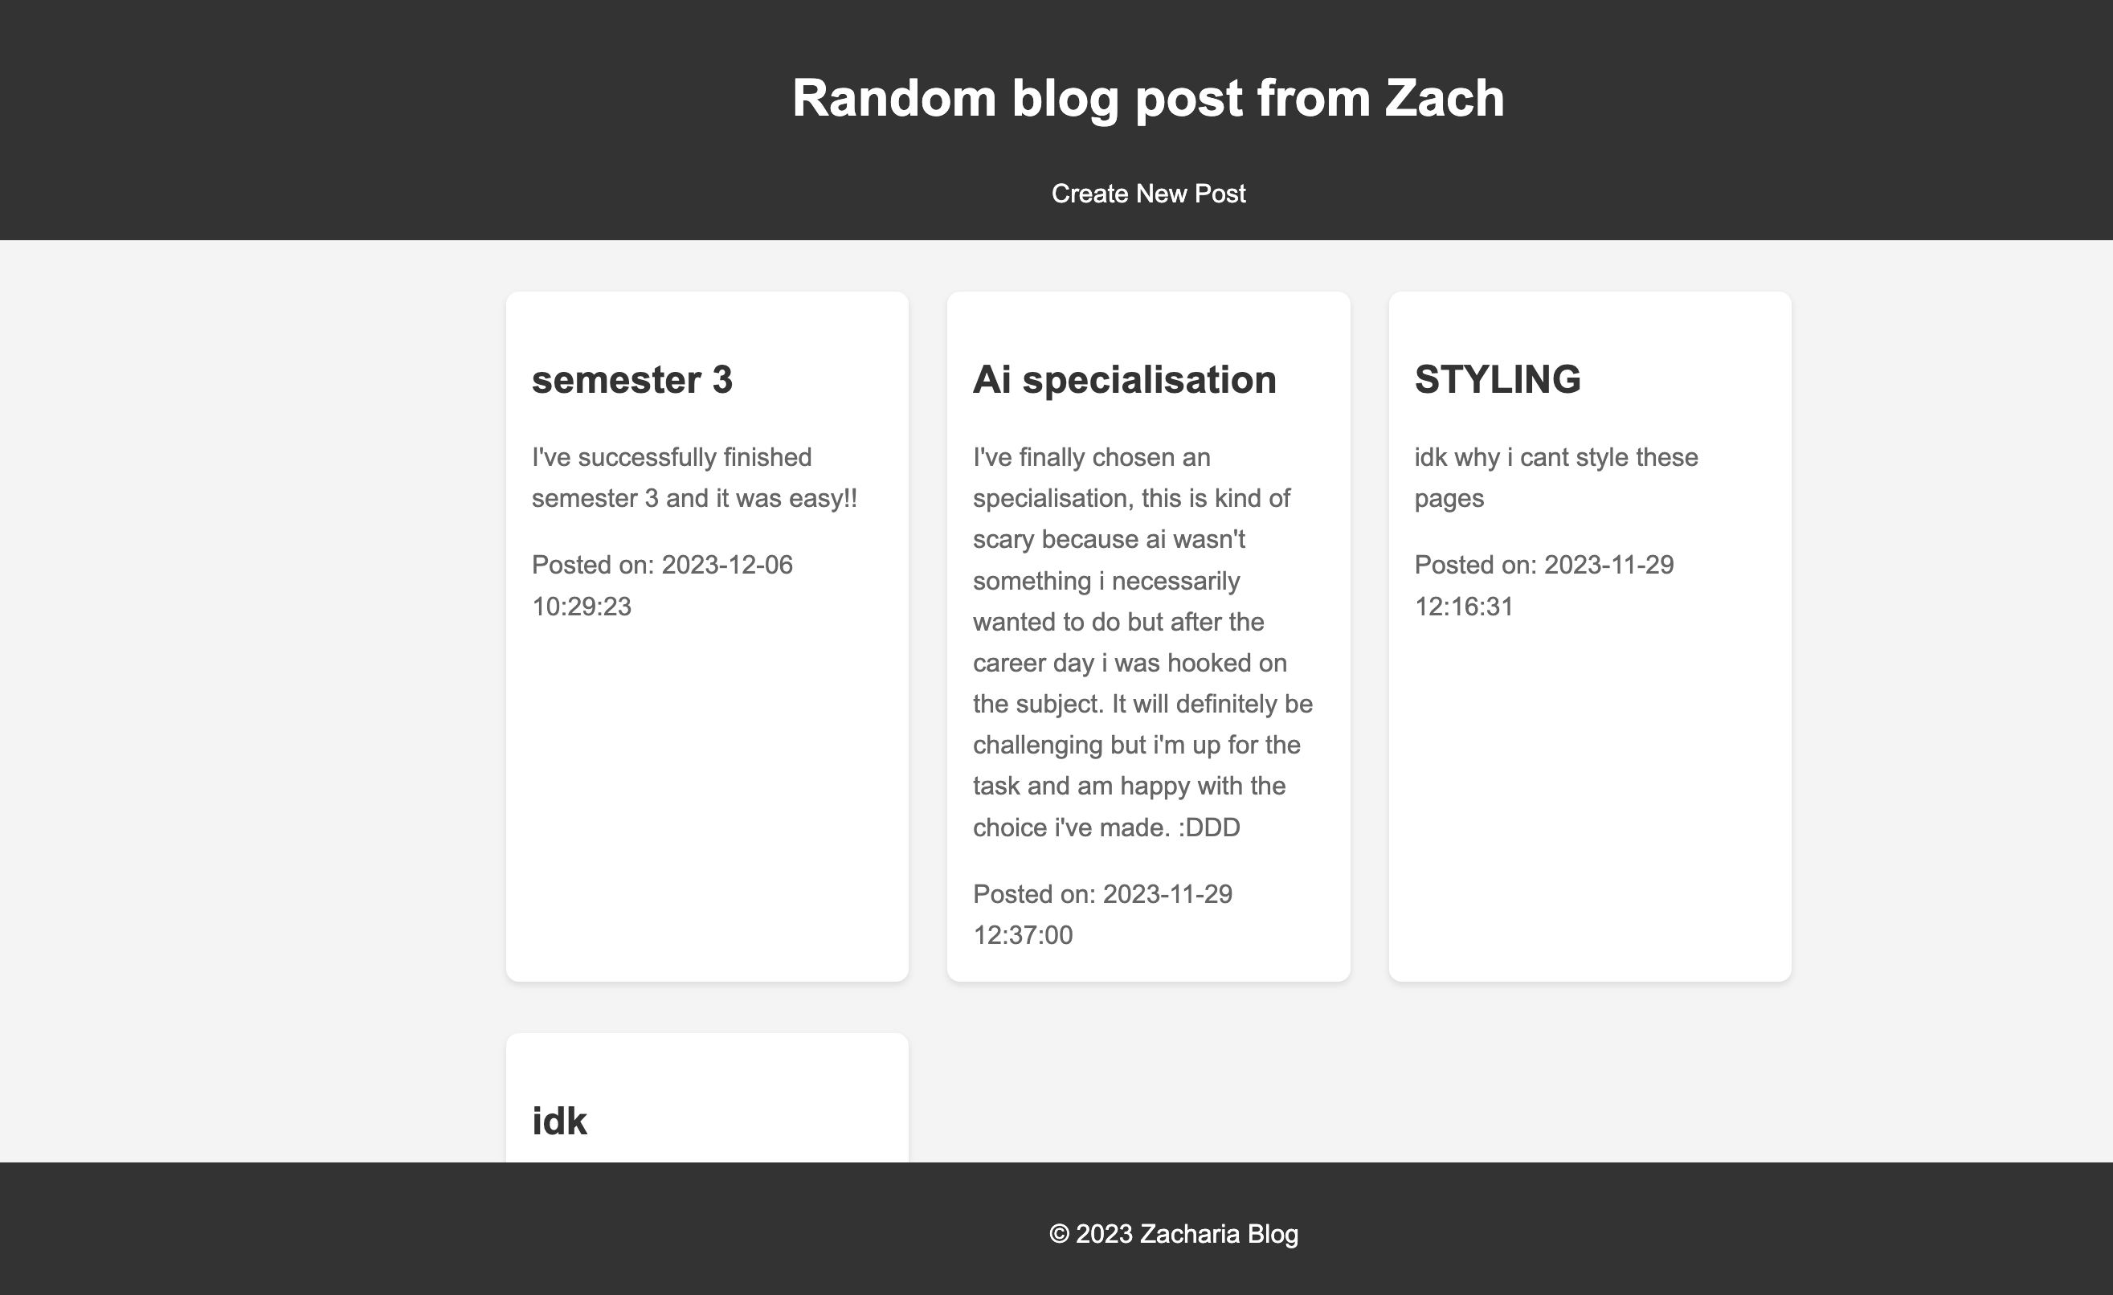

Slide 19
Learning outcome 3
“You present the successive iterations of your creative process, and the connections between them..”

Slide 20
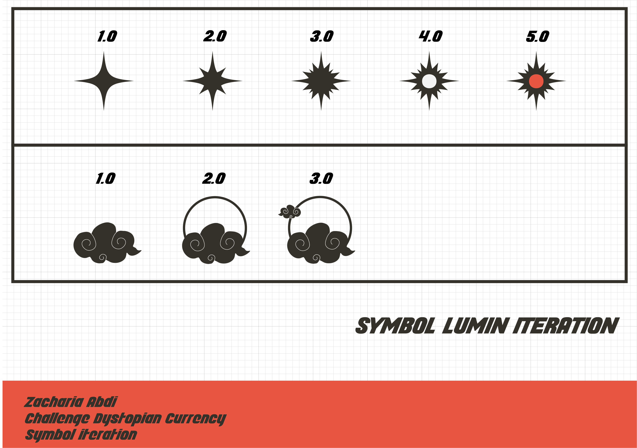

Slide 21
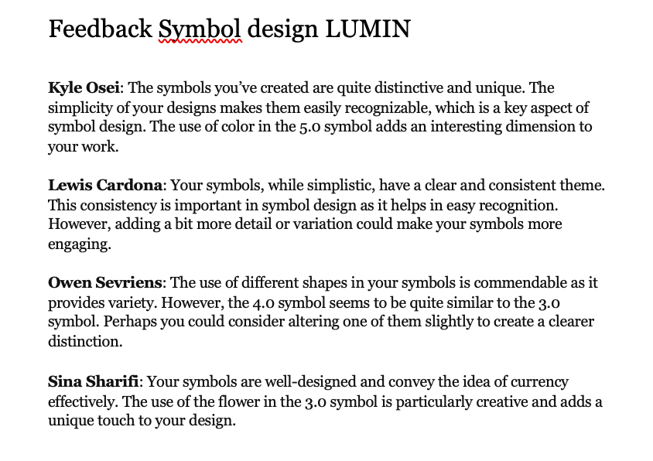

Slide 22
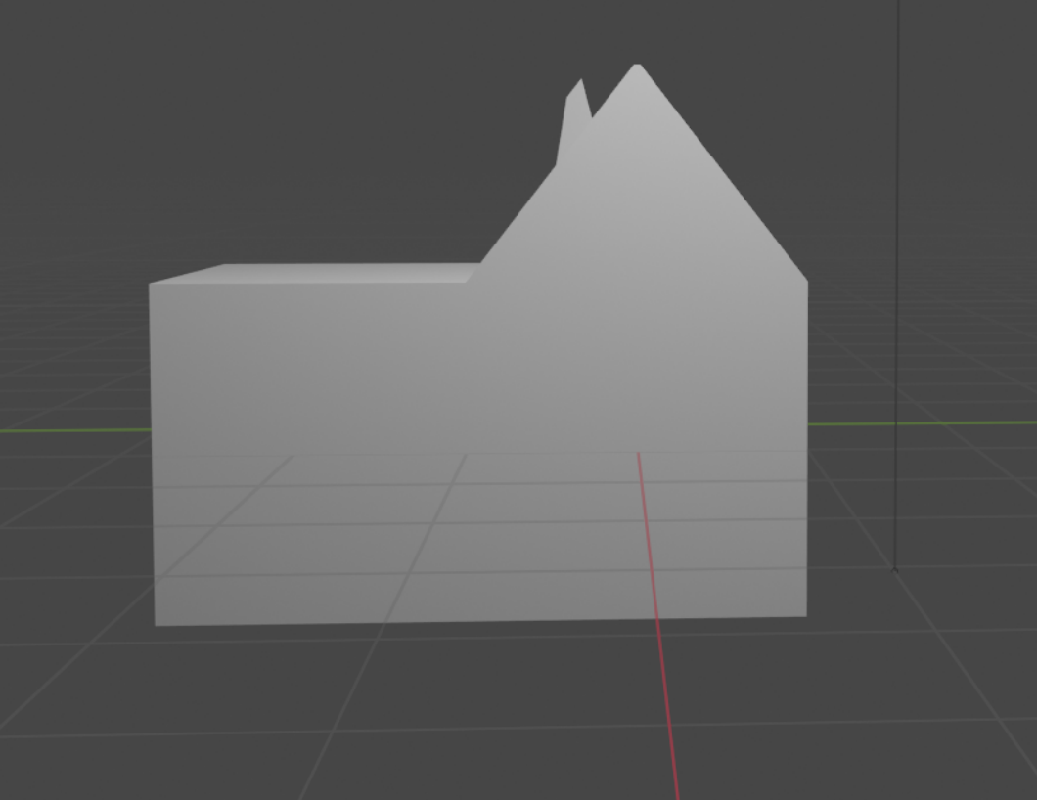

Slide 23
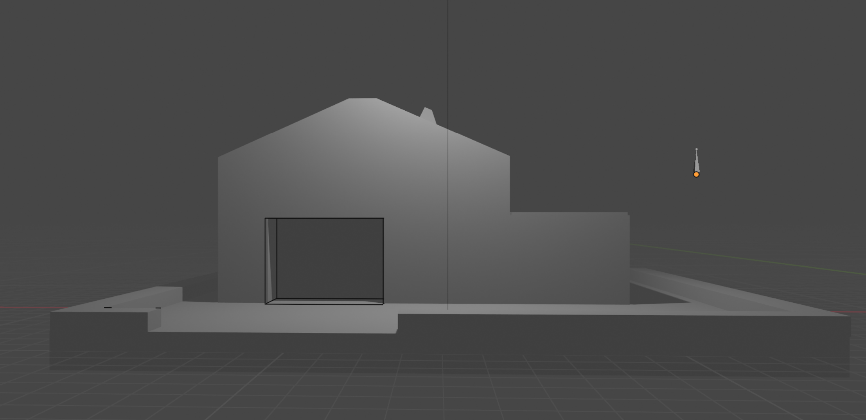

Slide 24
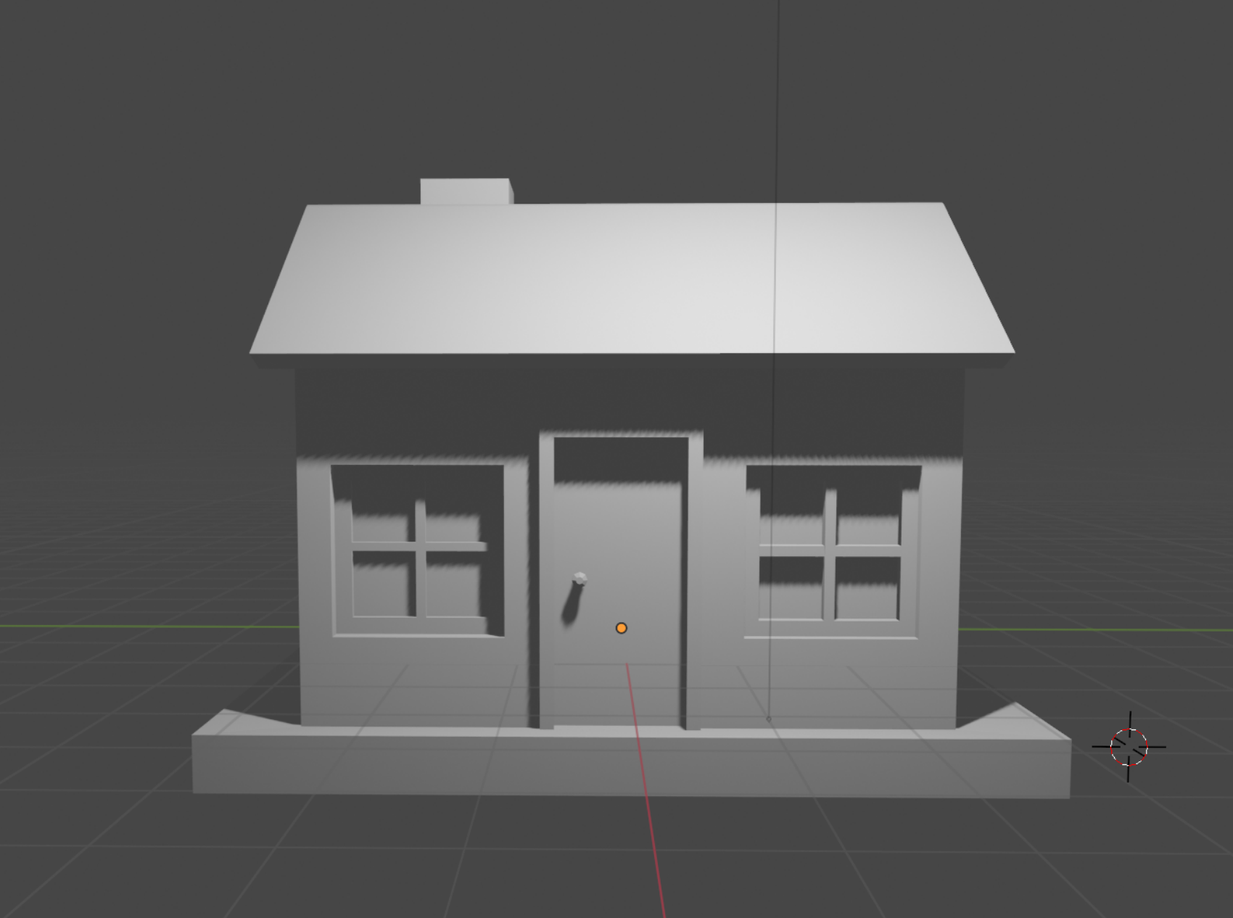

Slide 25
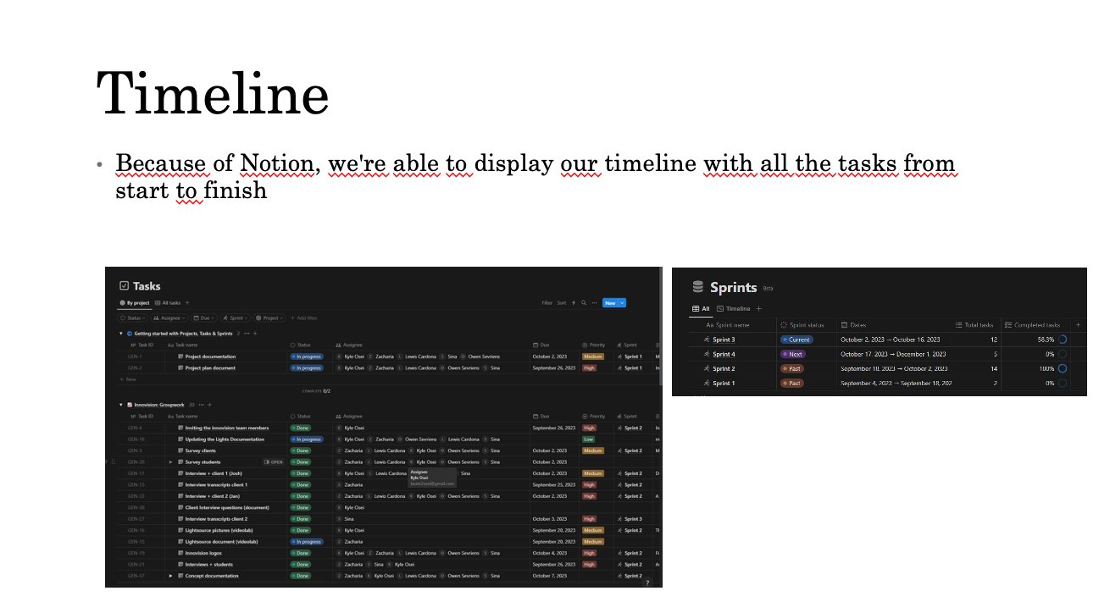
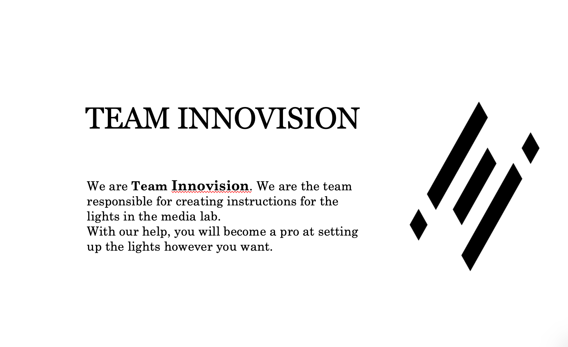
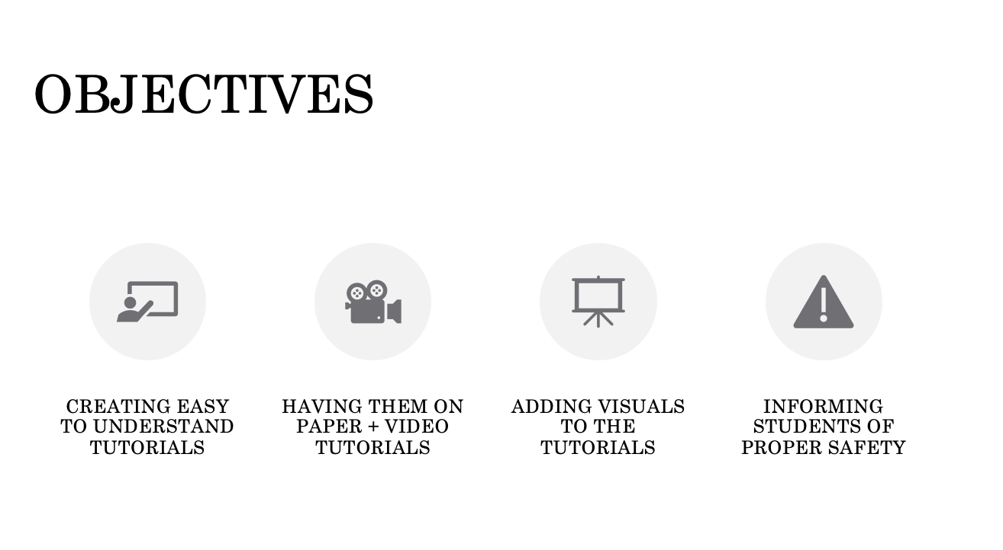

Slide 26
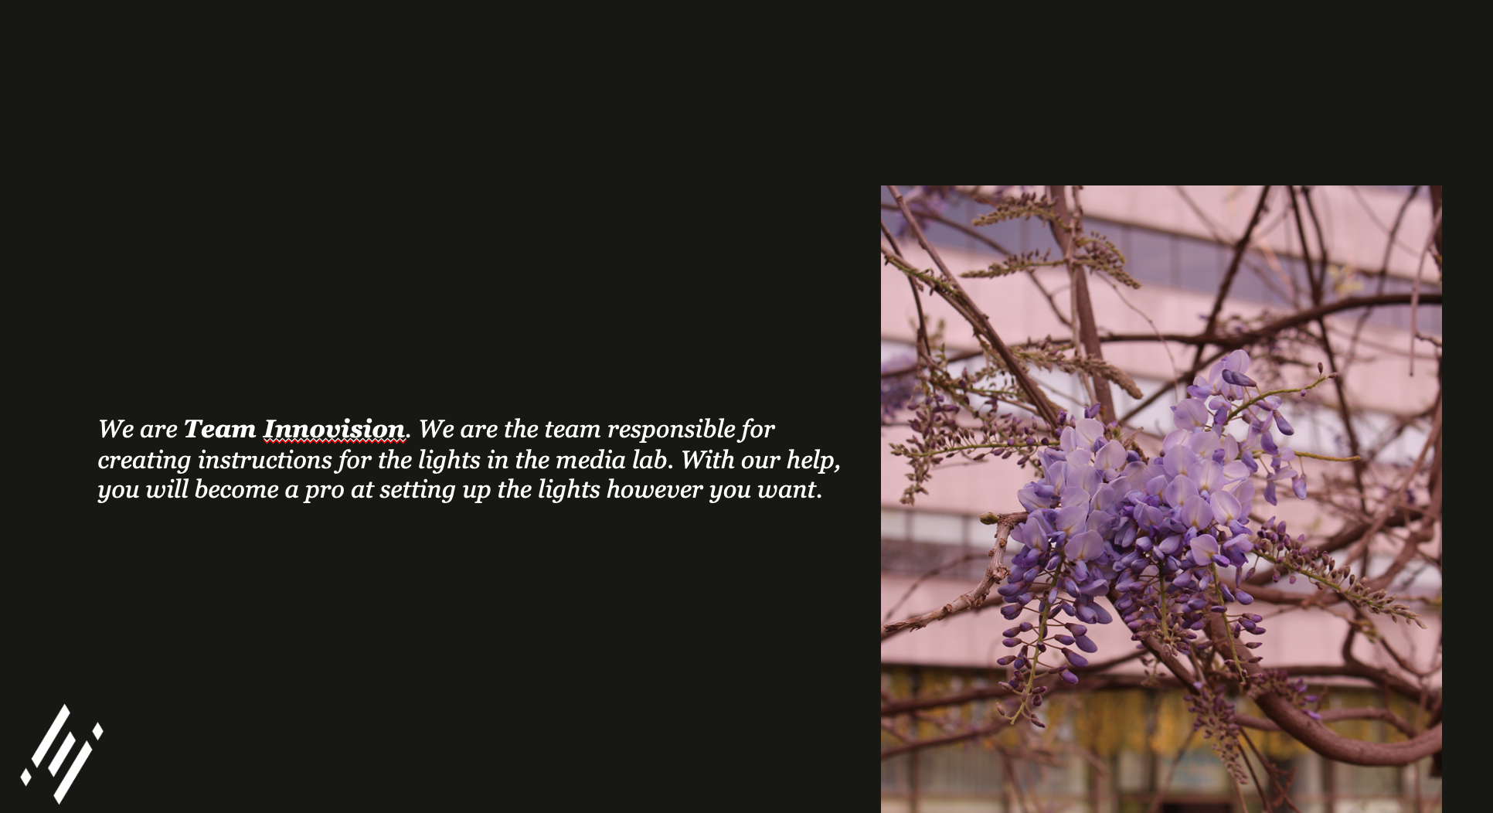
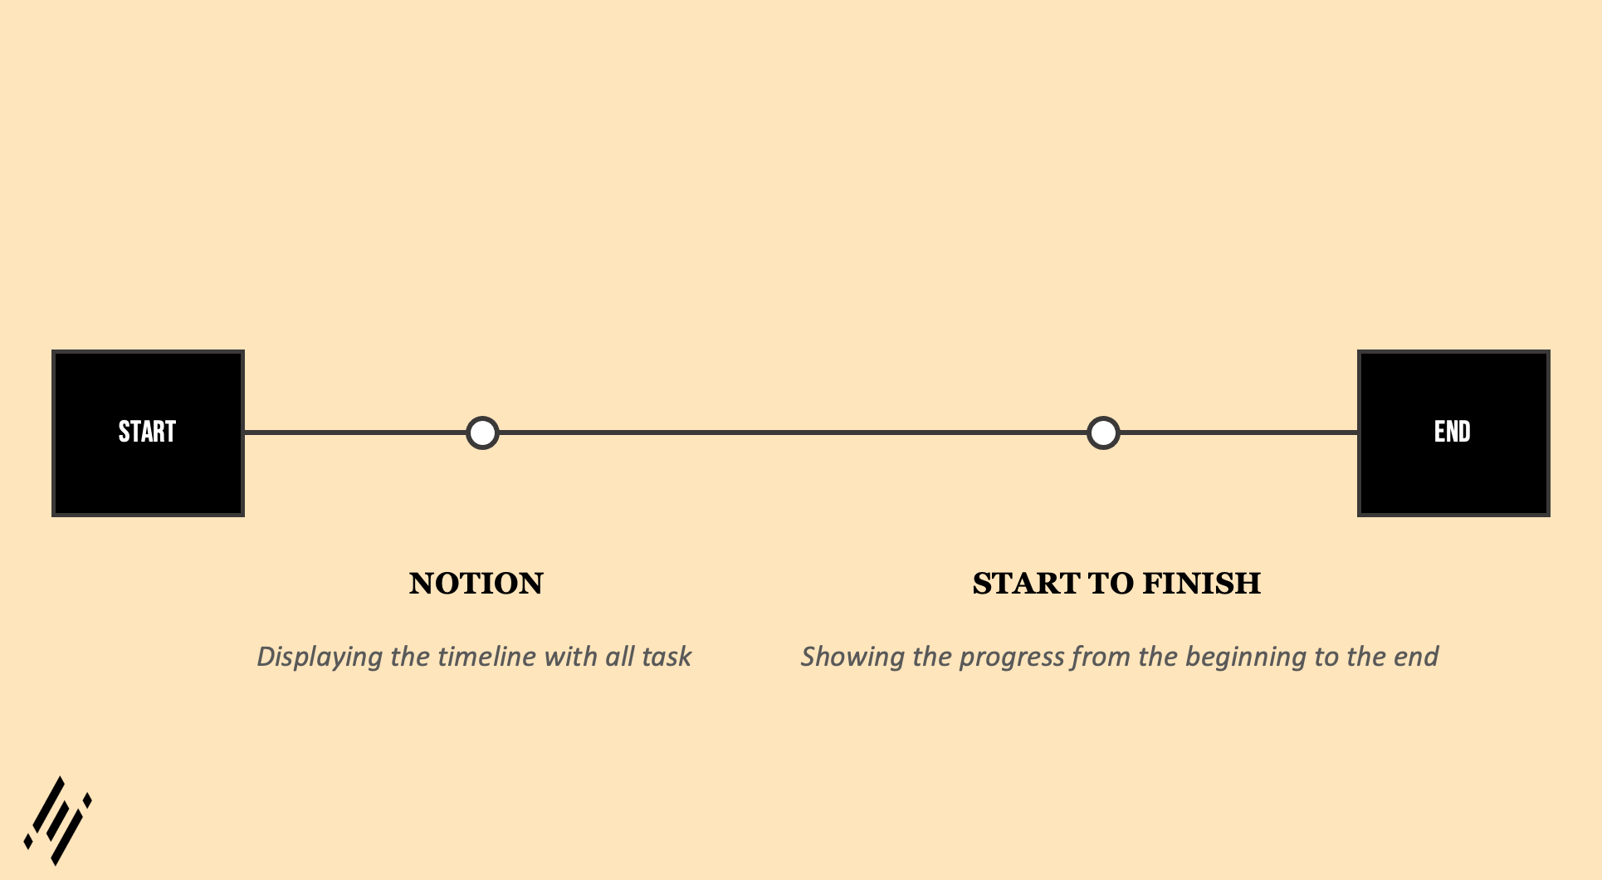
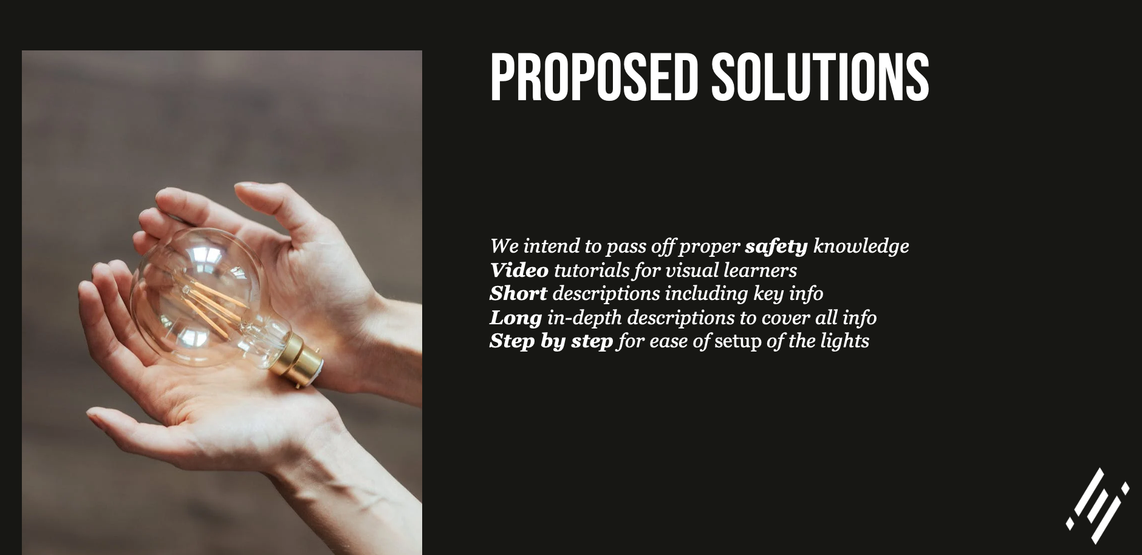

Slide 27
Learning outcome 4
“You show investigative problem solving, personal professional focus and have targeted interaction while actively orienting on the future working field of media design throughout the semester..”

Slide 28
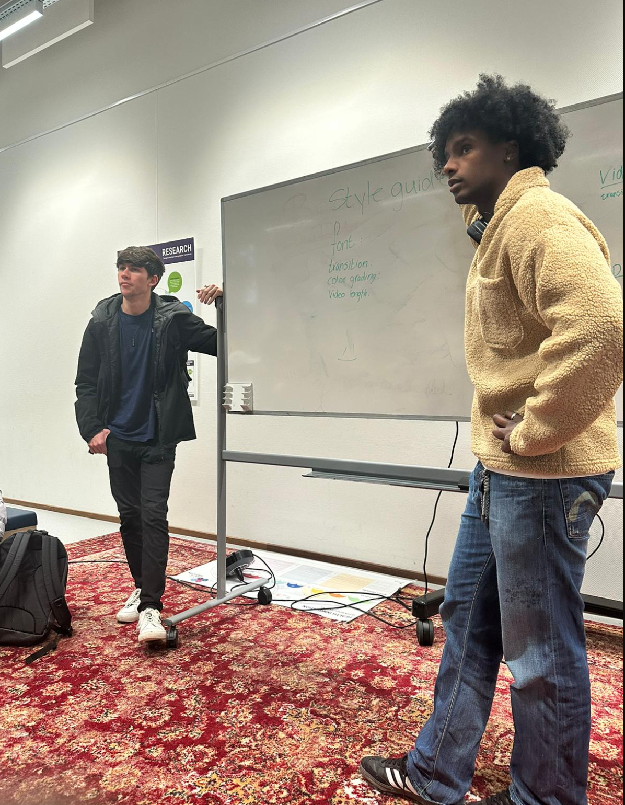

Slide 29
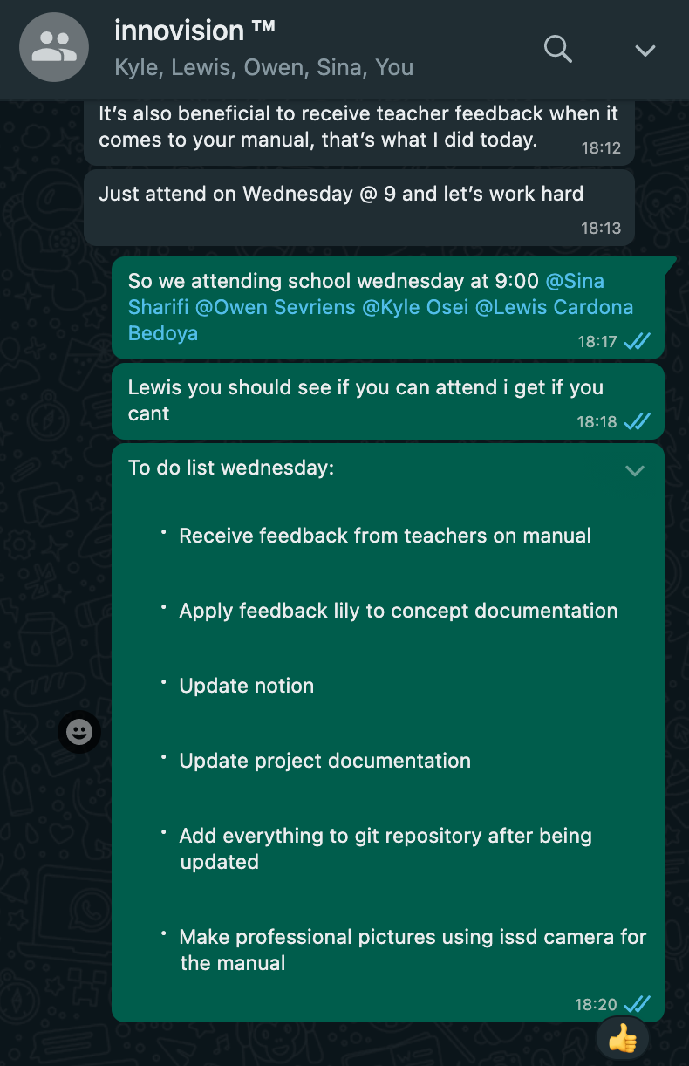
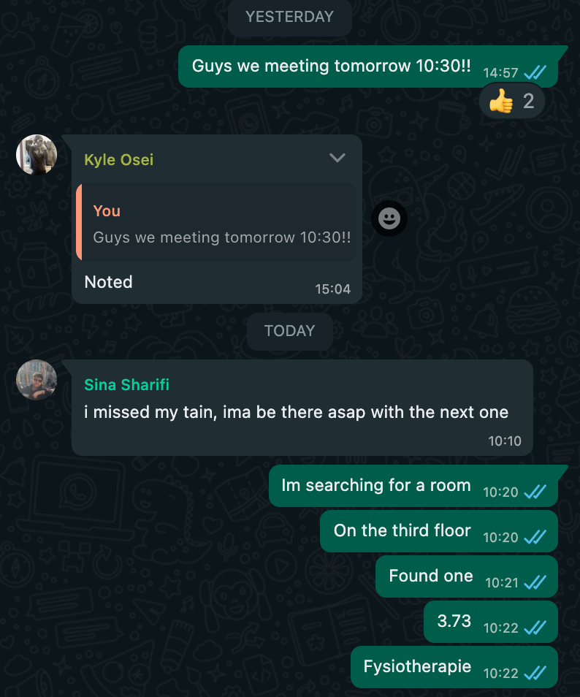

Slide 30
SO WHAT’S NEXT FOR ME?

Slide 31

SO WHAT’S NEXT FOR ME?

